Slide 1
Web Appraisal Sprint 3
Josh Basar, Alec Breslow, Kimberly Nguyen, Matthew Peace, Brent Schapman, Brian Shuryan

Slide 2
Where are we now?
Created Docker containers for running/testing our project, instead of us each having our own local hosting configurations
Completed all account management basics leftover from last sprint
User login
Account creation
Update account information
Delete account
Created base home page with mock data
Integrated Selenium into our project to test our product via automation, rather than manually

Slide 3
Sprint Milestones
This sprint we satisfied these user requirements: As a user, I want to edit and save account information, so that I can keep my information up to date
As a user I want to be able to logout of my profile when I am finished, in order to keep my information secure As a user, I want to be able to delete my account. As an administrator, I can delete users accounts, so that we can remove any unwanted users. As an administrator, I can reset passwords for users who are having issues logging in.

Slide 4
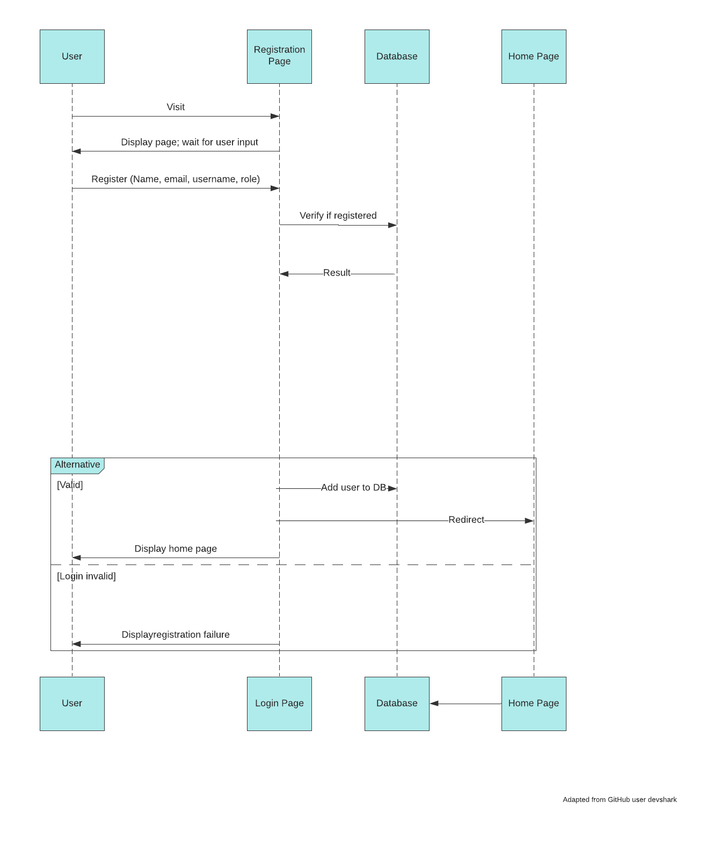
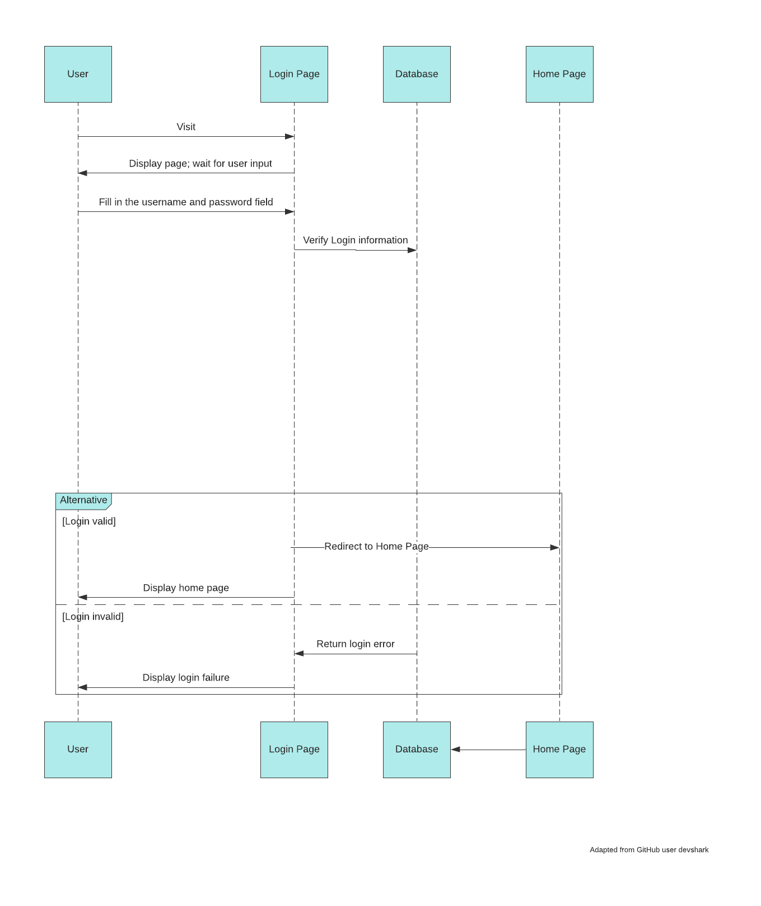
Diagrams
Registration Sequence
Login Sequence

Slide 5
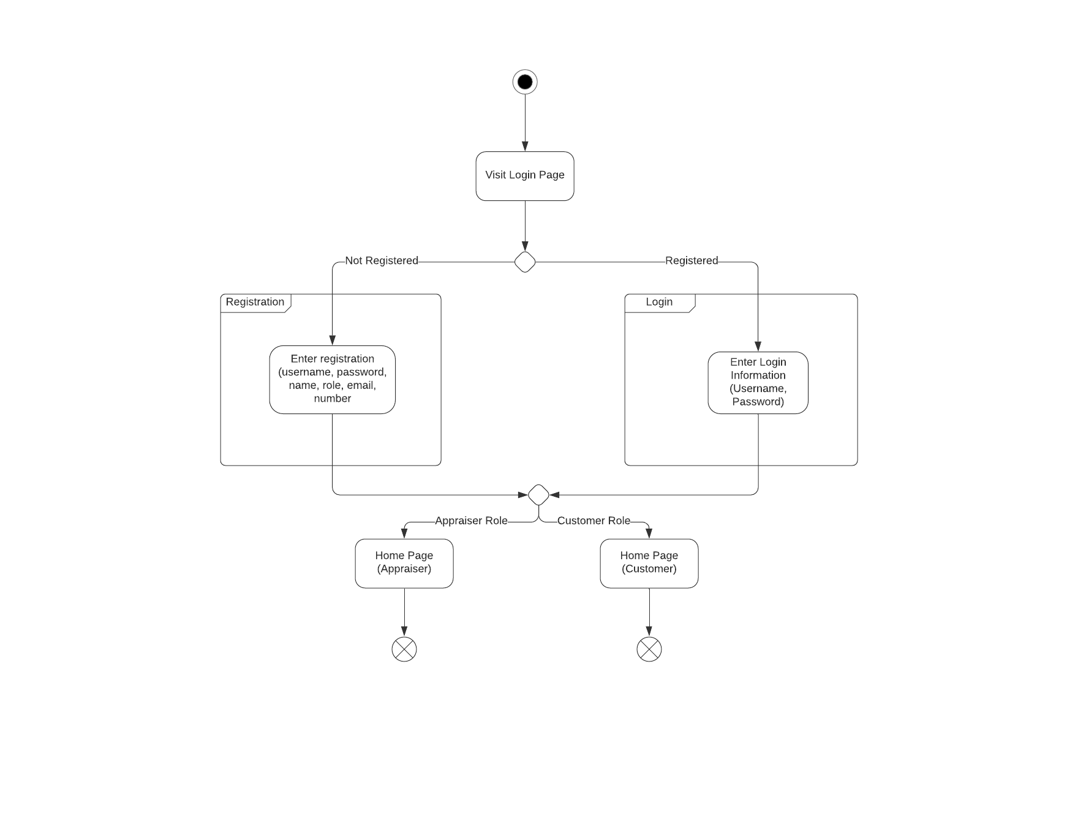
Diagrams
Registration/Login State Diagram

Slide 6

Des Cornish
“We need to be fast, but efficient”
Frustrations:
Does not have a quick and easy way to get information on his home
Spends to much time working
New to the homebuying process and finds it overwhelming
Bio: Des is a 28 year old Software Engineer from Bristol England. He has a knack for the work and excelled early in his career. 6 months ago he decided to take a job in LA, and is trying to find a house in the area. He finds the homebuying process cumbersome, especially when he is spending so much time working. With only his dog Fritz as a friend in the area he can't get the help he needs. Des is struggling and looking for a quick way to get information on his home options.
Traits
Curious
Cheerful
Clear-Minded
Impatient
Background
Age: 28
Job Title: Engineer
Interests: Reading, Working Out
From: Bristol England
Lives in: LA, California
Goals
Buy a home close to the office
Spend more time working self health, and less time working
Become a published author

Slide 7

Camille Tallo
“I can help with that!”
Frustrations:
Has no way to get her customers appraisals in a fast, digital fashion
Has to bring her computer and cameras to home appraisals
Sometimes finds it hard to share information and be transparent with her customers
Bio:
Camille is a real estate appraiser in LA, she has lived in the city all her life and loves it there. She enjoys helping people and being able to assist in fulfilling dreams by helping people find the perfect home. She is looking for a way to make her job easier, it is a burden for her to bring her laptop and camera to every home/appt she is appraising. She also wants to have a quick way to share appraisals making her job easier and speeding up the buying/selling process for her customers.
Traits:
People Person
Empathetic
Attentive
Helpful
Background
Age: 32
Real Estate Appraiser
Interests: Music, History
From/Lives in: LA, California
Goals:
Find a way to make her more efficient at her job
Improve communication channels with her customers
Travel to all seven continents

Slide 8
Sprint Challenges
General Github issues for those committing code for the first time
Initial Docker setup took some time and troubleshooting for those running different OS
Difficult to achieve a consistent UI when multiple developers are implementing their own pages in parallel

Slide 9
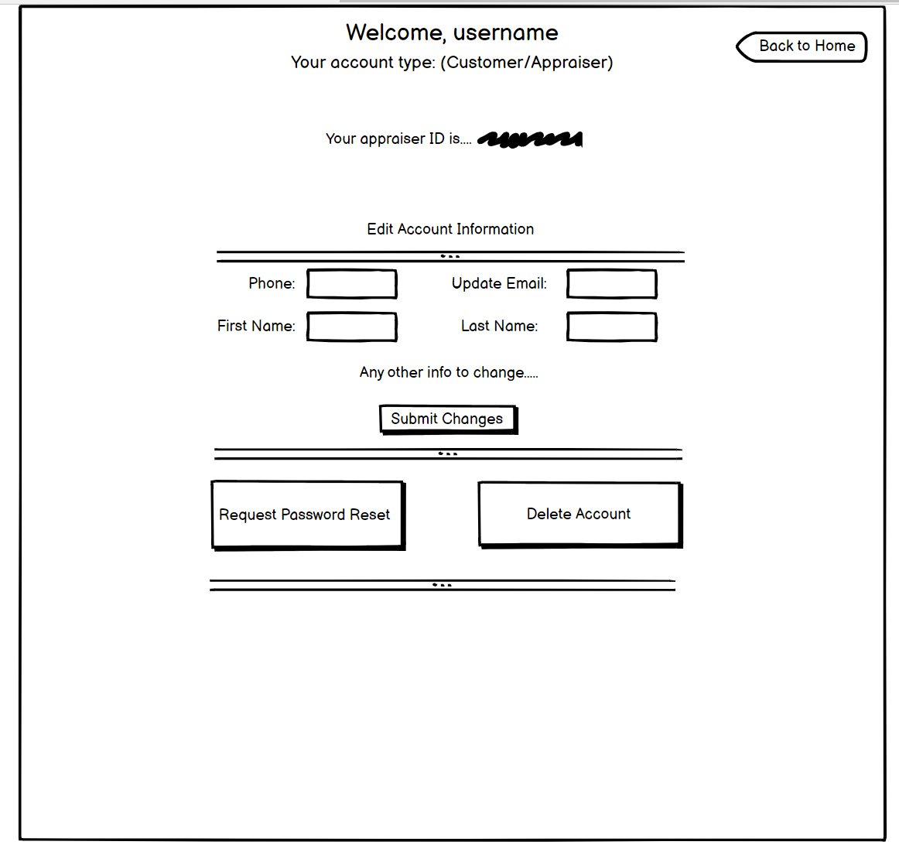
Initial UI Mockups

Slide 10
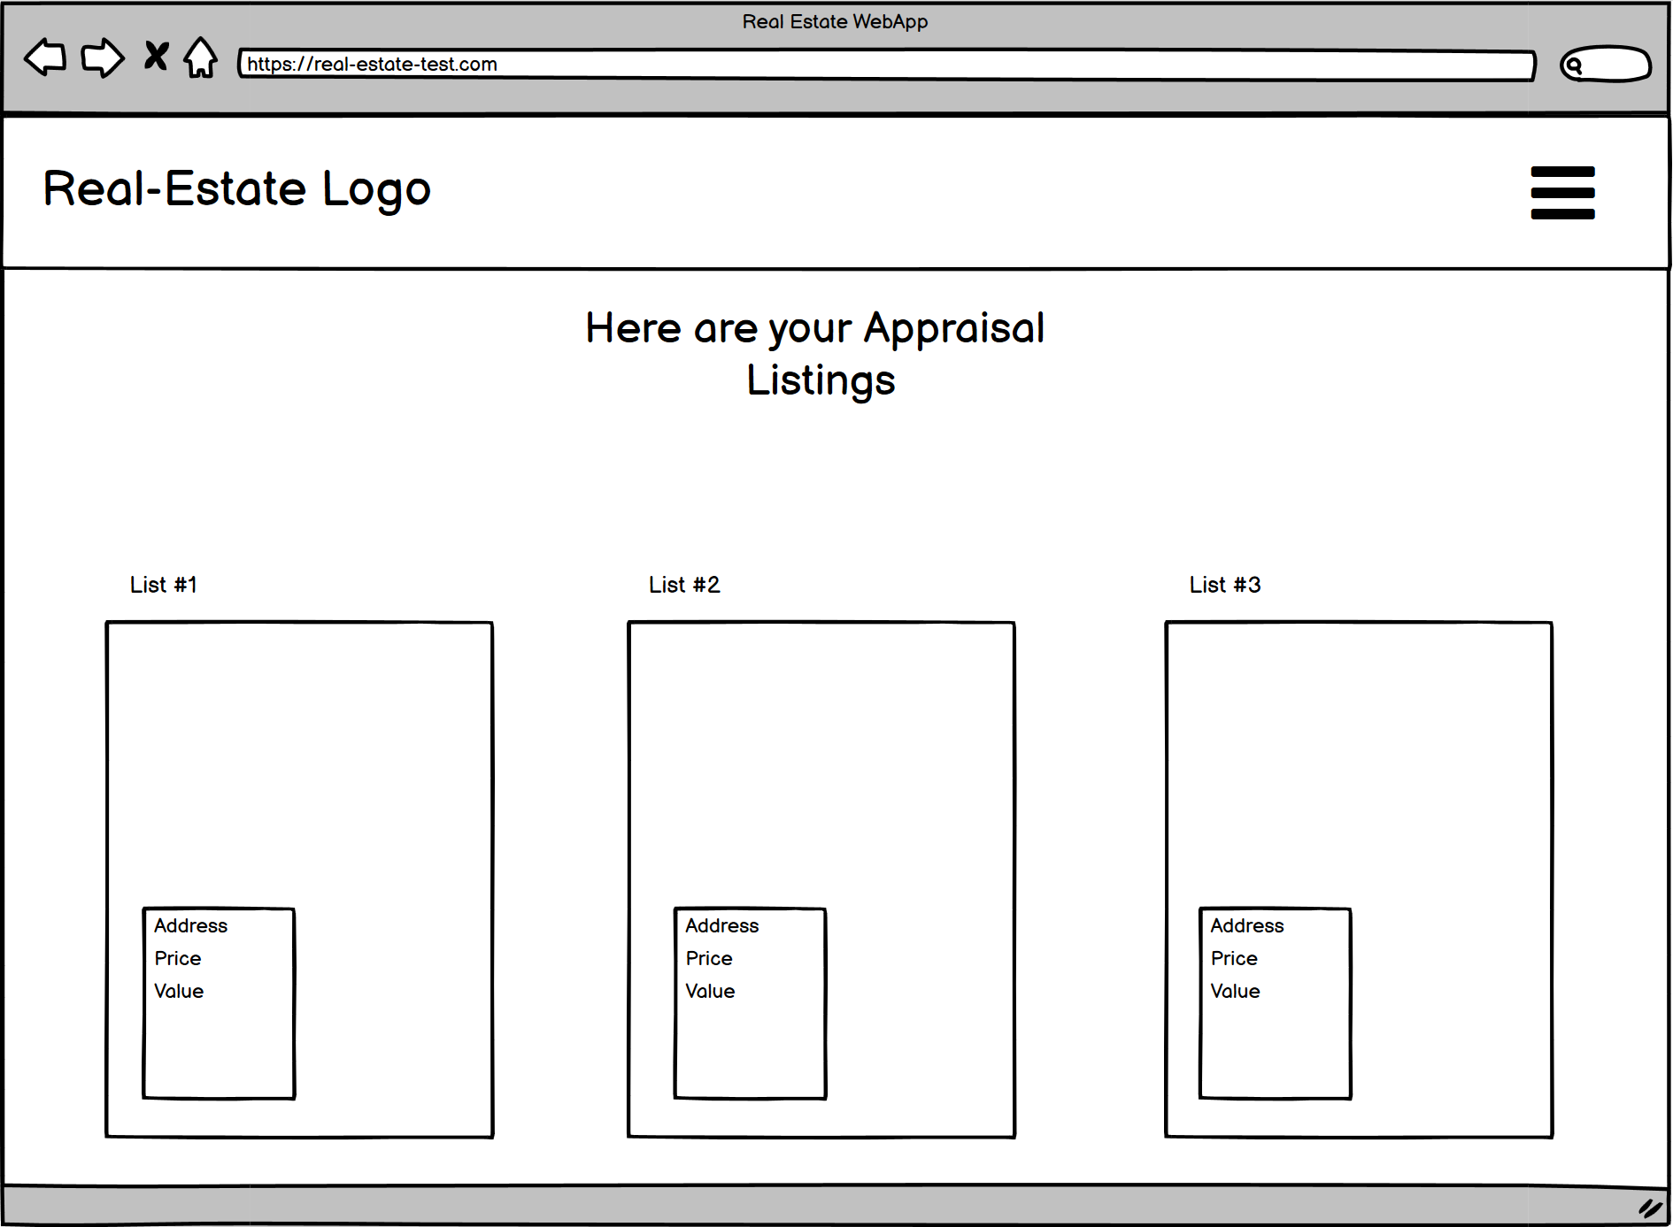
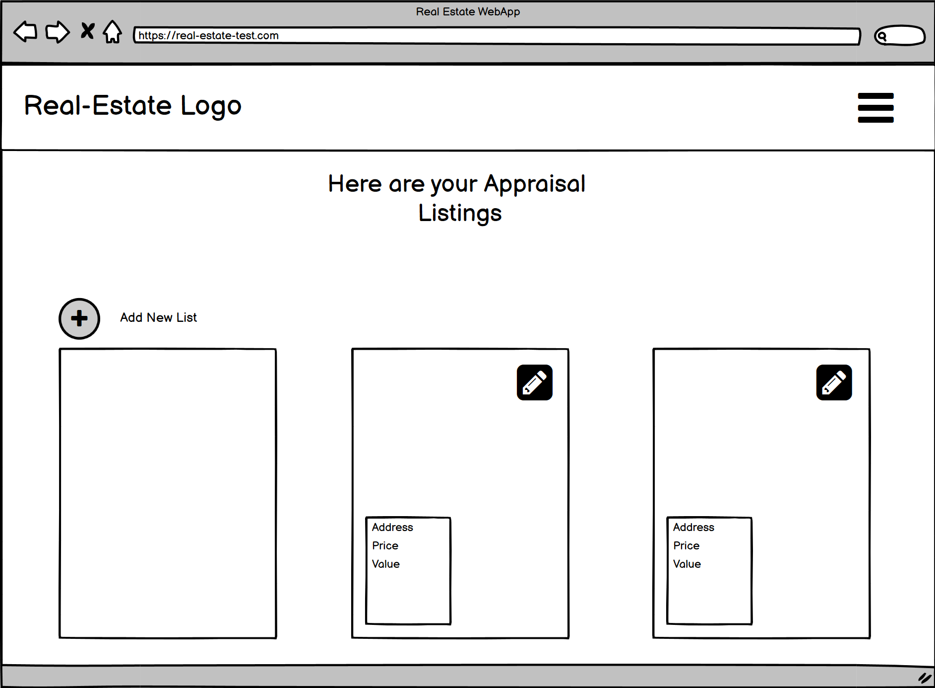
Initial UI Mockups

Slide 11
Demo!!

Slide 12
Next Sprint Objectives
Populate home page with actual data
Individual appraisal detail pages and forms
Mobile UI Optimization
Start investigating in-app photo taking*
This may be pushed back another sprint depending on progress

Slide 13
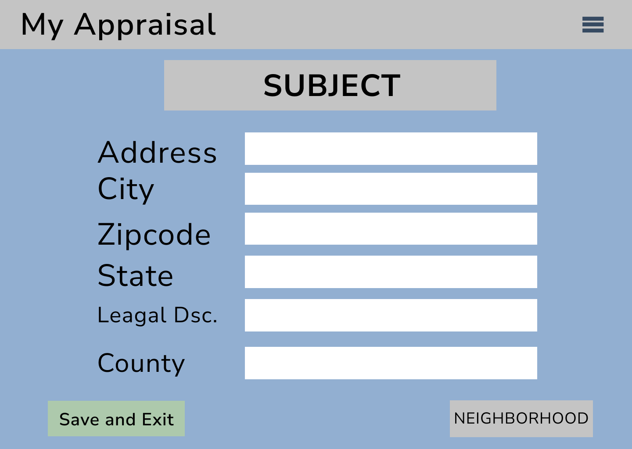
UI Concepts for Next Sprint

